Slide 1

SAI VIDYA INSTITUTE OF TECHNOLOGY
Department of Computer Science and Engineering
Accredited by NBA, New Delhi
Rajanukunte, Bengaluru - 560064
Internship (18CSI85) Presentation on
Design and Implement Backend Server(Timer, User Respone Time, Unauthorized Access) for online MCQ/SBQ Platforms
Internal Guide
Sreelatha P K
Assistant Professor
Dept, of CSE
Presented By
Darshika B
1VA18CS009
External Guide
Abhinav Kumar Abhay
Software Developer
K-AKA Technology Services
2021-22

Slide 2
Presentation Outline
About the Organization.
About Department.
Task Performed.
Reflection Notes.
References.
Dept. of ISE, SVIT

Slide 3

About Organization
K-AKA is a fast and growing software company, started in the year 2020 to provide the best services to the user's needs.
It is a (SaaS) Software as a service company, currently growing its network in the Bangalore, New-Delhi, etc.
This company focuses on the multiple domain such as :
1)Training
2)Development
3)SaaS(Software as a Services)
4)Consultancy
Dept. of ISE, SVIT

Slide 4
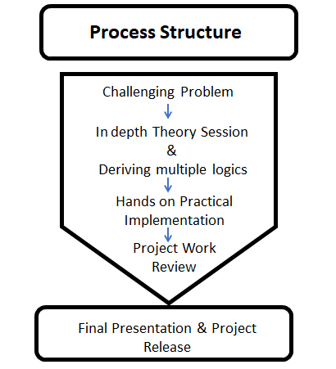
About Department: Process Structure
Dept. of ISE, SVIT

Slide 5
Task Performed
Full Stack Web Development.
Learnt Front-end framework.
Learnt Backend Technologies.
Designed and Implemented MCQ and SBQ Exam Platform.
Implemented specific timer for registration form and also included user Response time for each of MCQ/SBQ Exam.
Added the functionality for Unauthorized Access

Slide 6
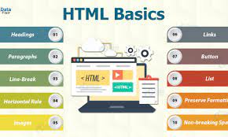
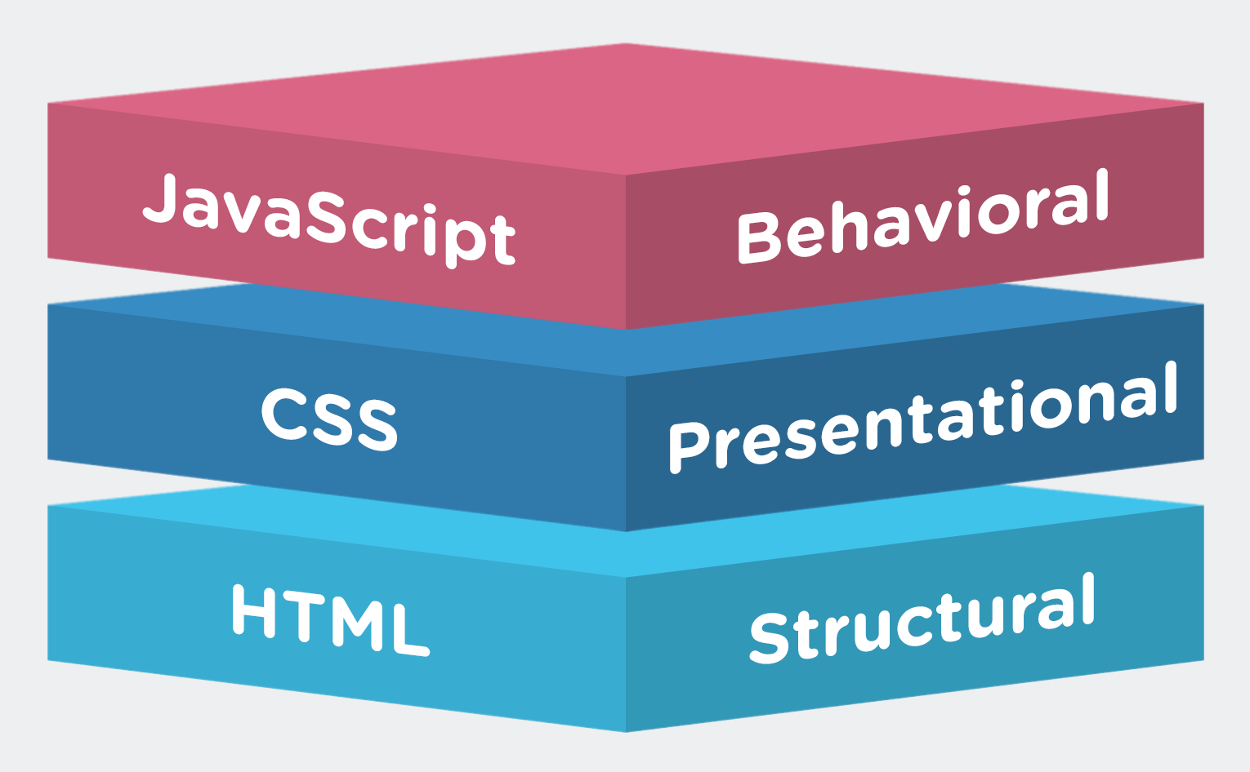
Front-End Framework
HTML : It is a Front-end Web Framework
Dept. of ISE, SVIT

Slide 7

Backend Technology
Firebase
Email and Password Authentication
Email Sign up
Store data into real-time database
Access the data from real-time database
Store image into real-time database
Dept. of ISE, SVIT

Slide 8




Requirements
• Front-end :HTML,CSS
• Back-end : Firebase
• Language used: JavaScript
• IDE Used : Sublime
Dept. of ISE, SVIT

Slide 9
Overview
Once after registering for the exam, the candidate can take up MCQ exam.
After taking up MCQ platform, only if the average marks or qualifying marks is scored by the candidate, he/she can take up SBQ exam.
Both for MCQ and SBQ exam timer will be set.
Until the candidate takes up MCQ exam , he/she cannot take up SBQ exam.
Dept. of ISE, SVIT

Slide 10
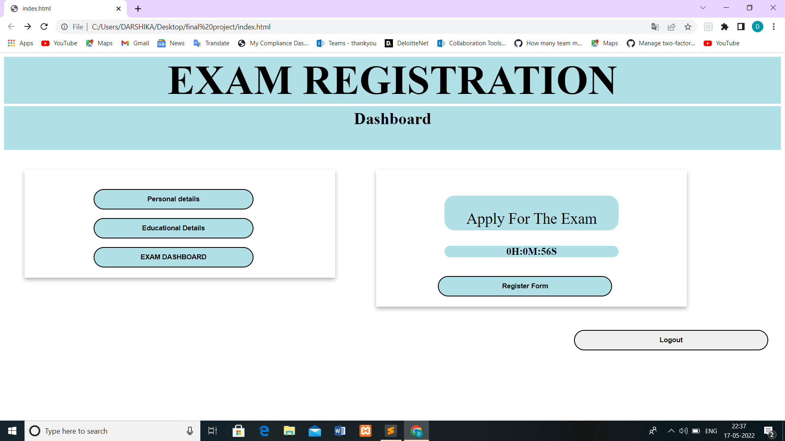
Project Snapshots:
Timer is given to complete the registration form
Dept. of ISE, SVIT

Slide 11
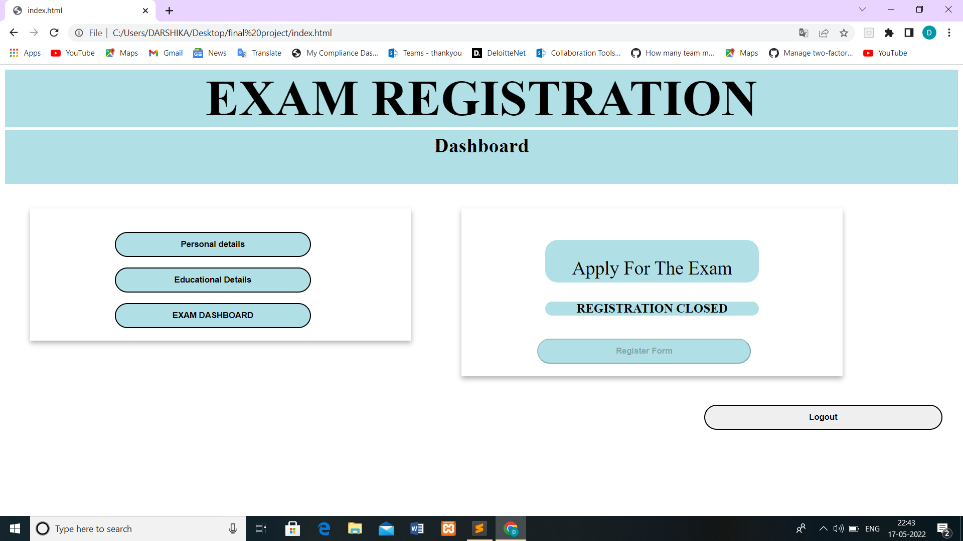
Project Snapshots:
Registration form closed after the desired Time
Dept. of ISE, SVIT

Slide 12
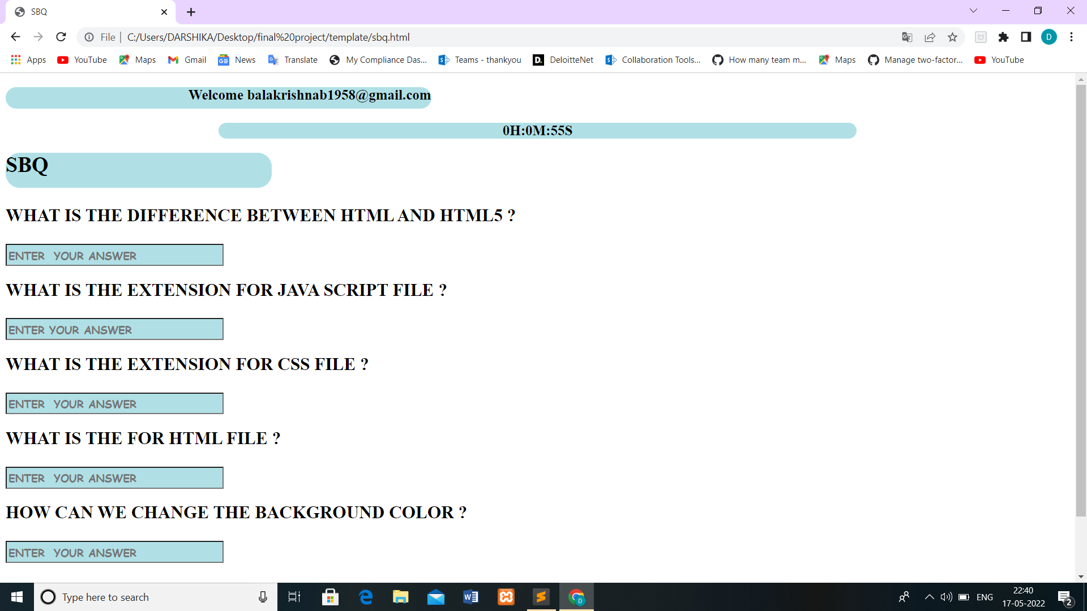
Project Snapshots:
SBQ exam to be completed with the allotted time
Dept. of ISE, SVIT

Slide 13
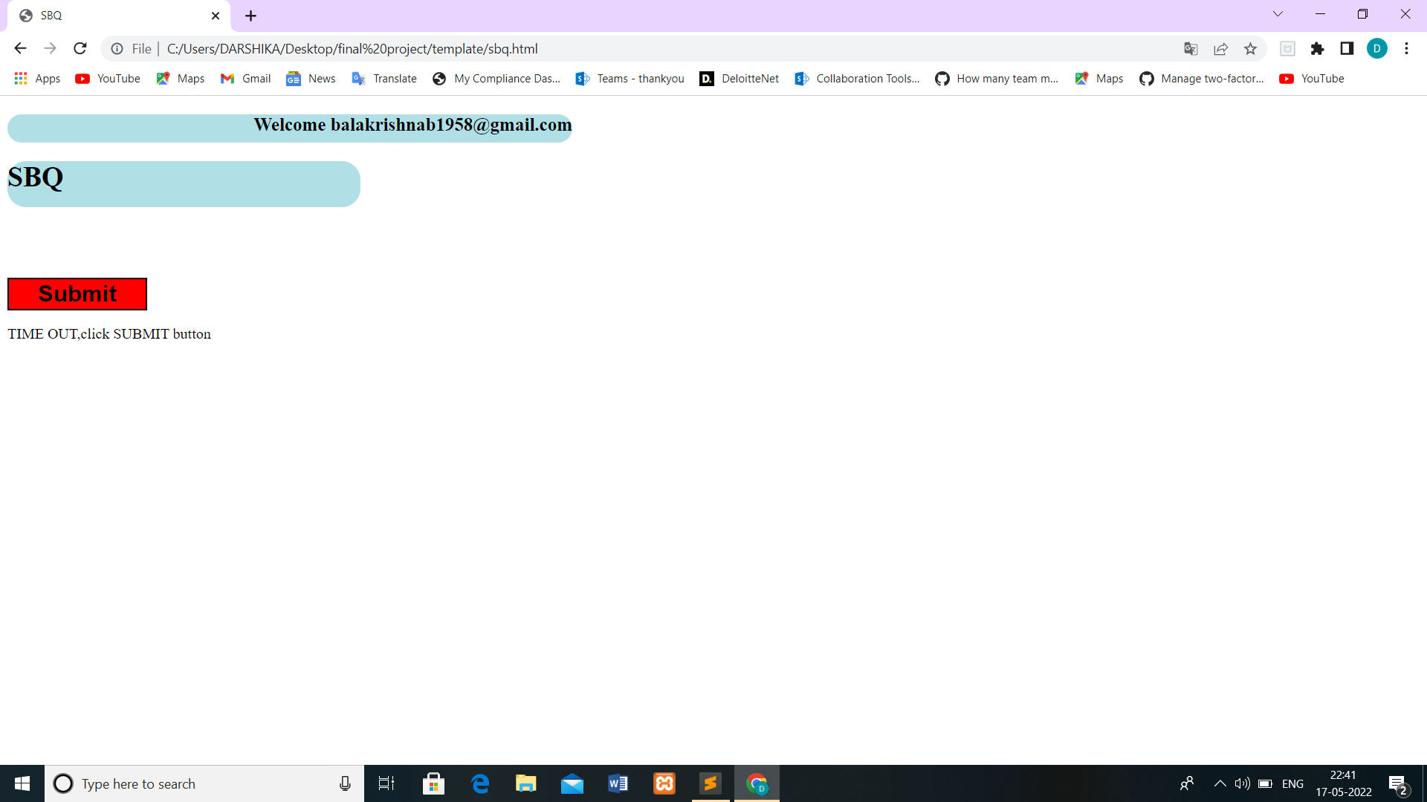
Project Snapshots:
SBQ exam Closed
If exceeds the given time.

Slide 14
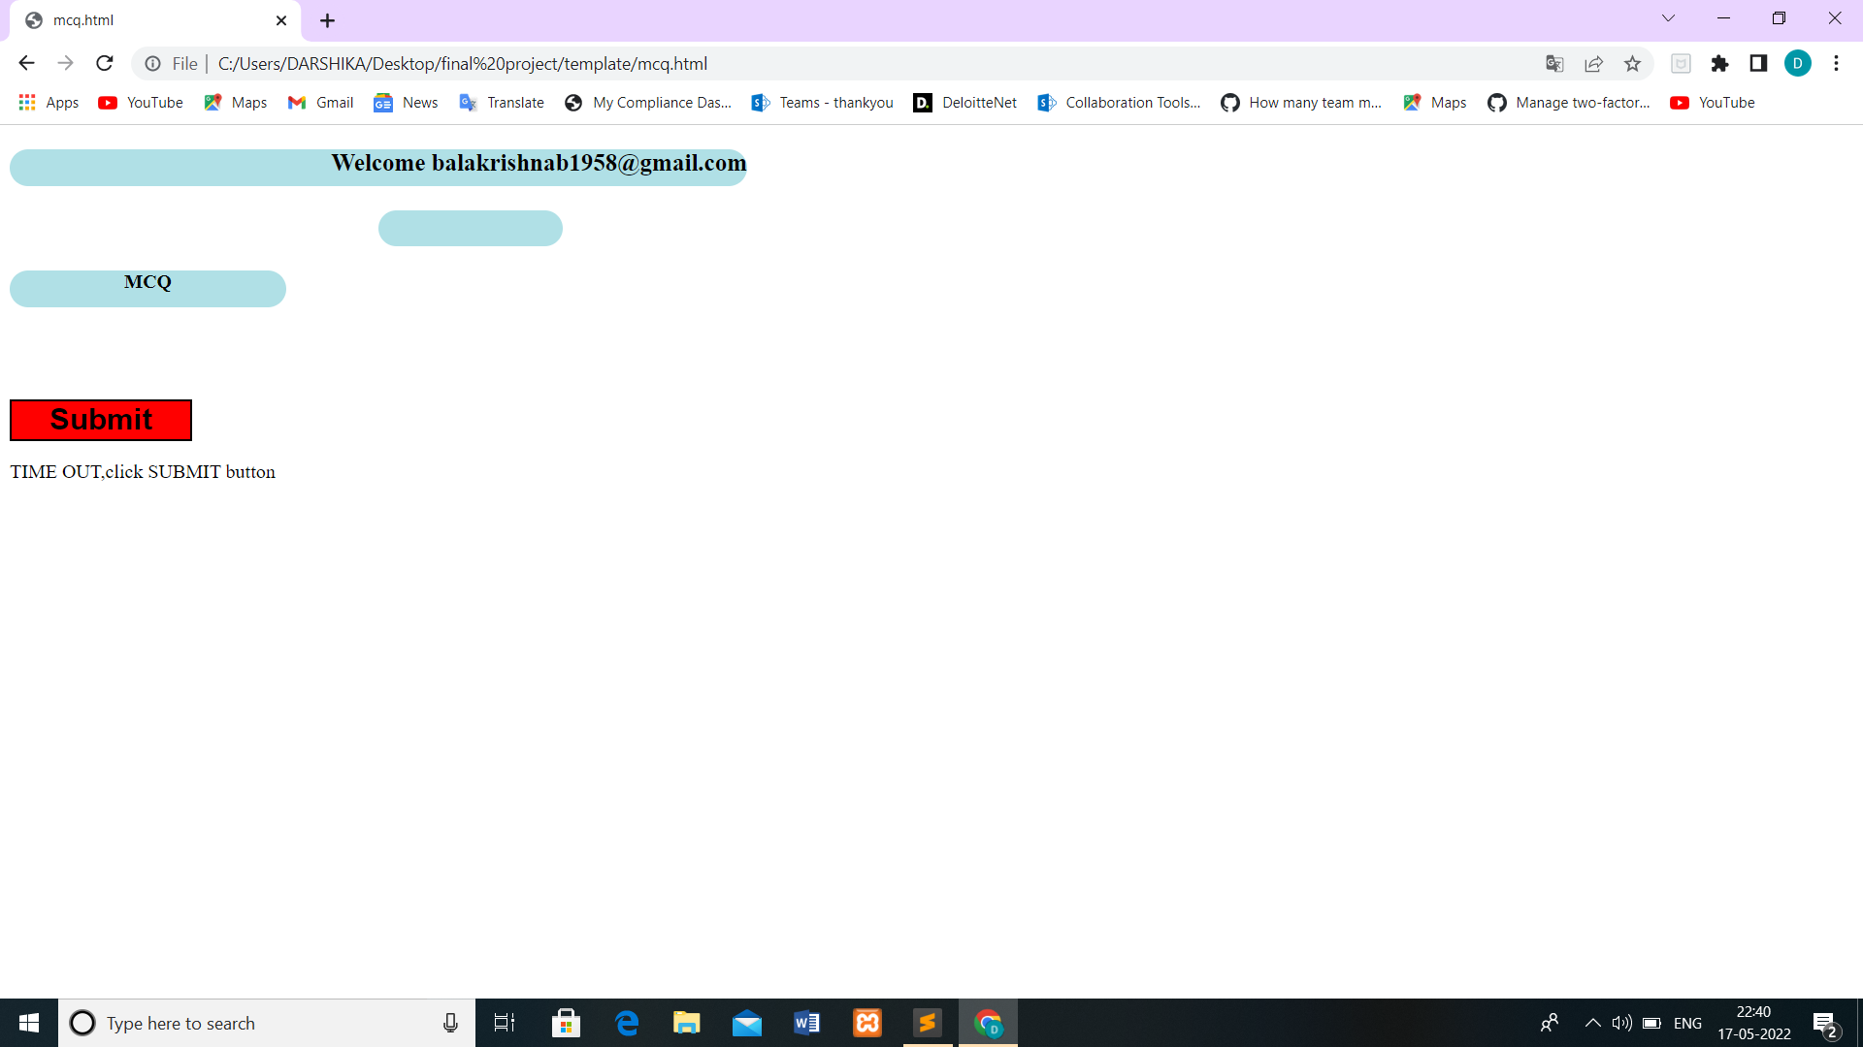
Project Snapshots:
MCQ exam Closed If exceeds the given time.

Slide 15
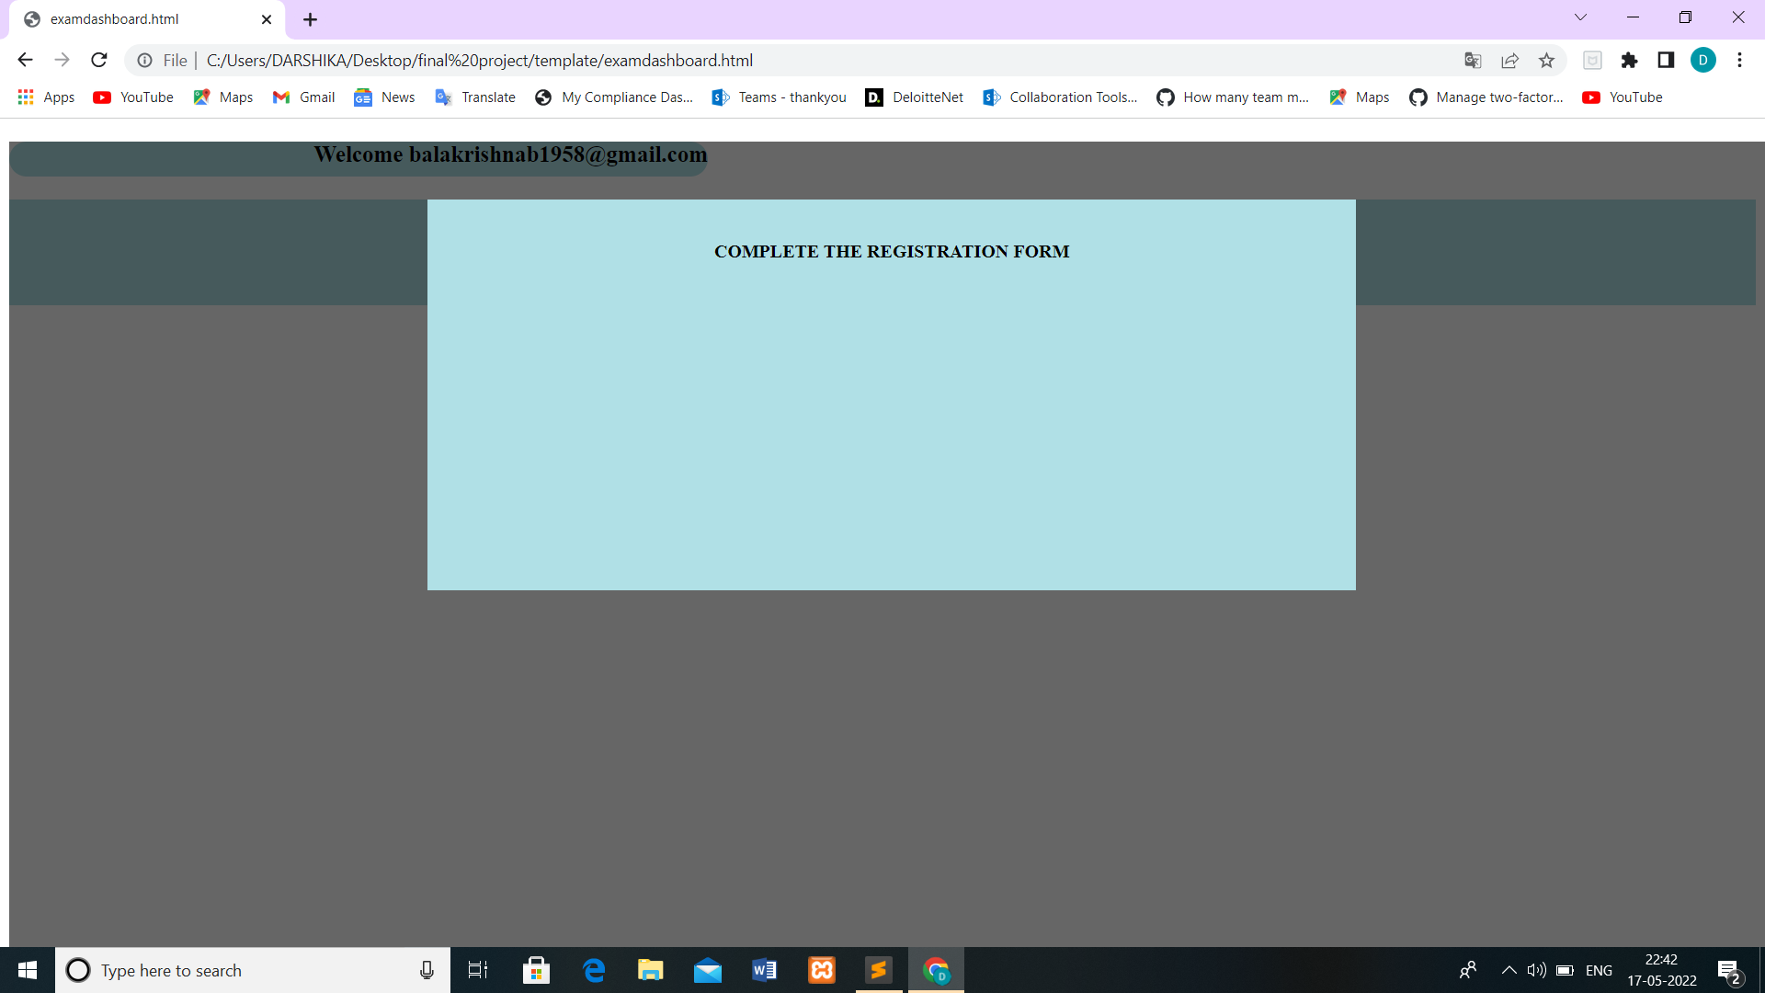
Project Snapshots:
Enabled Exam Dashboard once registration is done

Slide 16
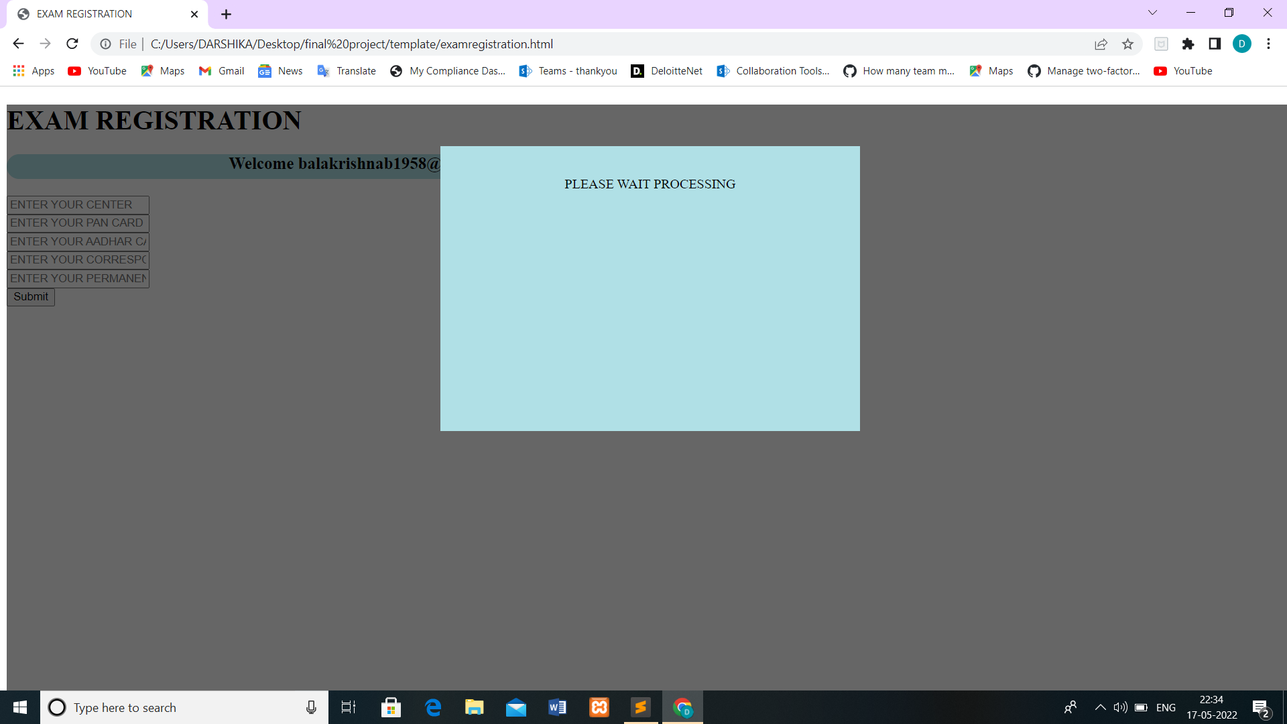

Exam Registration enabled only if Personal details and educational details are completed

Slide 17
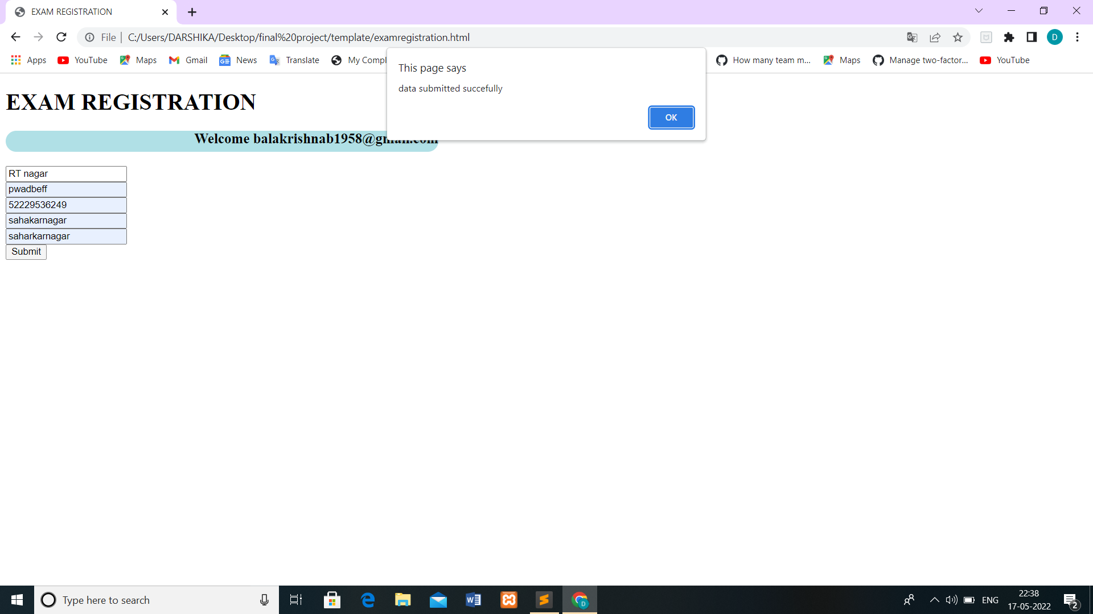
Project Snapshots:
Exam registration enabled

Slide 18
Reflection Notes
.
I am glad to share my experience about the internship.
I have learnt a lot of things related to html, css, java script . Internship was very informative, and I gained a lot of knowledge about python. I got a good experience with hands on session which was very helpful.
I thank our trainer for teaching so well.
Dept. of ISE, SVIT

Slide 19
References
.
https://www.geeksforgeeks.org/python-tkinter-tutorial/
https://www.tutorialspoint.com/firebase/index.htm
https://www.javascript.com
Dept. of ISE, SVIT

